Slide 1


STA 380 | Summer 2023
Airline Customer Booking Prediction
Predicting customer likelihood to book a flight ticket

Slide 2

Passenger airline is one of the most competitive industries in the world
About 6 million people fly to somewhere every day - 0.1% of global population
These people use one of the 5000+ registered airlines in the world
Despite this, in 2023, the IATA projects a net profit margin of just 1.2% for airlines

Slide 3

Problem Overview
Predicting whether a customer will book a flight ticket or not based on the itinerary details provided by the user at the time of booking

Slide 4
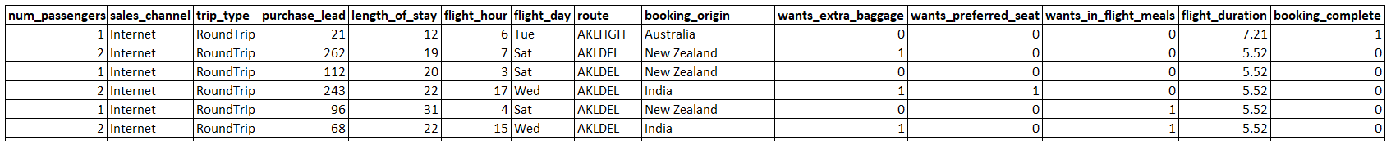
Dataset Overview
The number of passengers associated with each booking
Specifies whether the booking is for a one-way or round trip
The duration of the stay
Indicates the day of the week for the flight
Describes the source of the booking i.e. Country
Specifies if the customer expressed a desire for preferred seat during the flight
Duration of flight
How customer reached to the website
Days between the booking date and the date of travel
Specifies the hour of the flight
Specifies the flight route taken by the customer
Indicates whether the customer expressed a desire for extra baggage allowance
Specifies if the customer expressed a desire for a meal during the flight
Indicates whether the customer successfully booked a holiday or not
Notes:
Booking_complete will be response variable

Slide 5

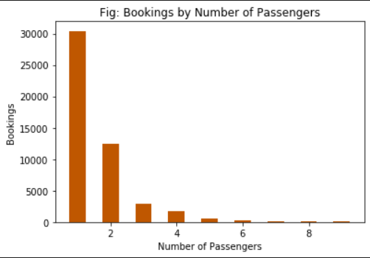
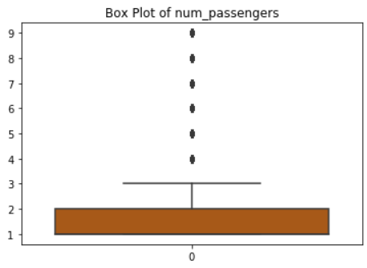
Data Exploration Insights - Number of Passengers
~88% of the booking comprises of 2 or less passengers
Majority of bookings have <=2 passengers leading to other no. passengers as outliers
Notes:
The number of passengers represented in this data is skewed towards fewer passengers (particularly <=2), which seems realistic to what we would expect in reality but may be worth considering in our analysis.

Slide 6
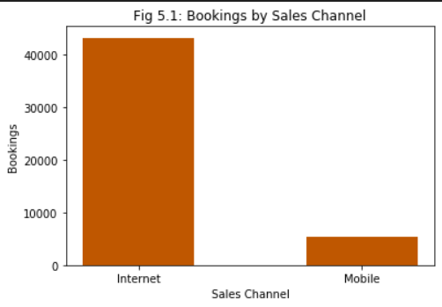
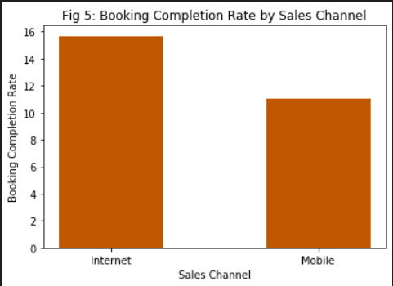
Data Exploration Insights – Sales Channel
~89% of the bookings are through the Internet
While majority of booking happens through internet, the booking completion rate is comparable in both channels
Notes:
Internet significantly outweighs Mobile in terms of booking volume, though the difference in booking rate between the two is less drastic (but still some difference with Internet ~4% higher rate)

Slide 7
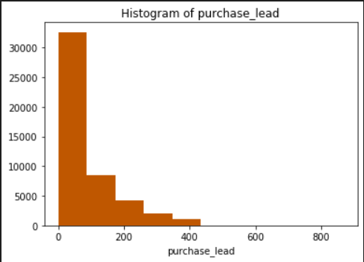
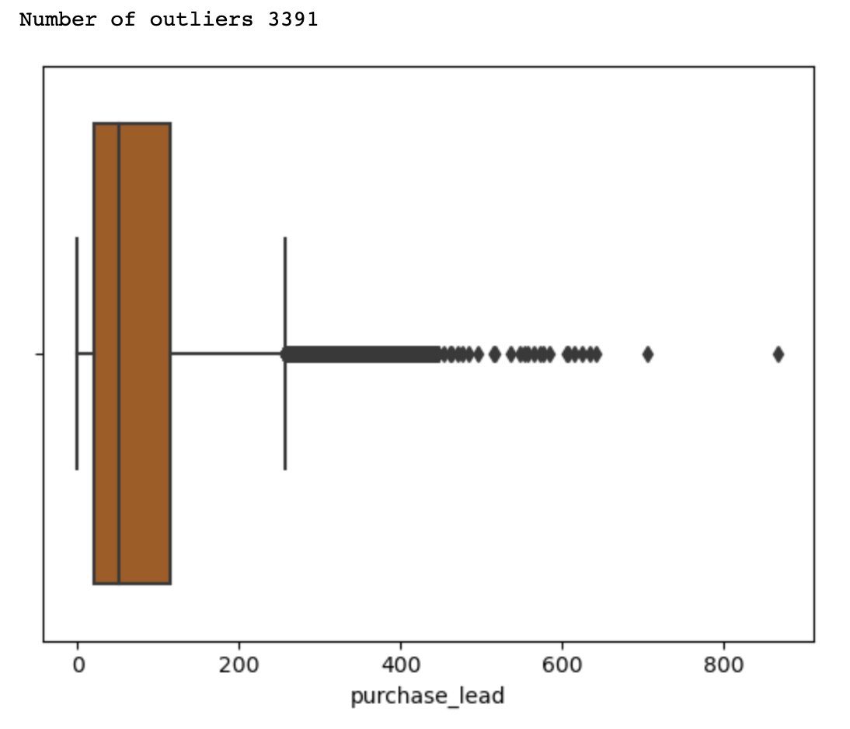
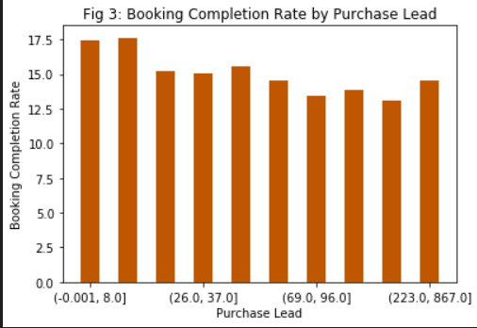
Data Exploration Insights – Purchase Lead
Majority of the bookings are planned for in the upcoming 100 days
Only a fraction of bookings are made more than a year in advance
Purchase lead has no significant impact on Booking completion rate
Notes:
Similar to what we saw with num_passengers, there is a skew in the purchase_lead data (which once again is probably realistic but just worth observing).

Slide 8
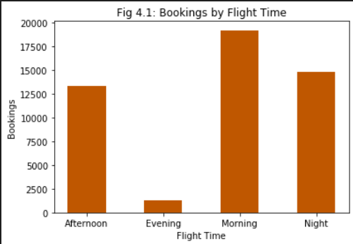
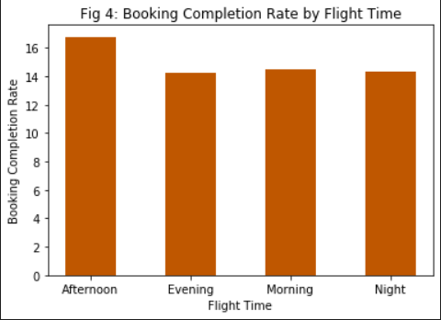
Data Exploration Insights – Flight Time
Morning is the most preferred travel time while evening is the least preferred
Bookings made for afternoon have a slightly better completion rate than others
Notes:
In terms of booking volume, there are some clear differences with morning as the clear highest volume and evening the clear lowest. When it comes to booking rate, however, these differences are much less drastic and not necessarily aligned with the volume.

Slide 9
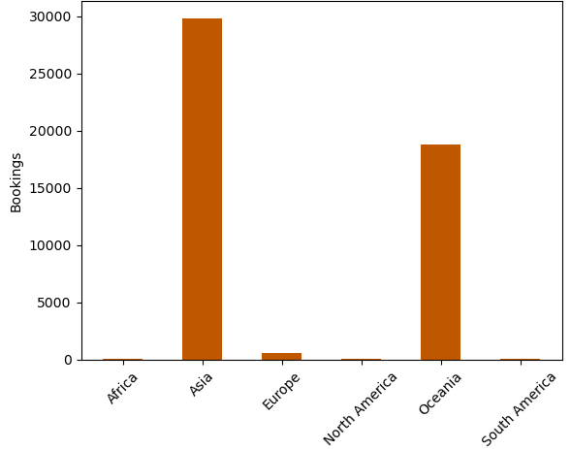
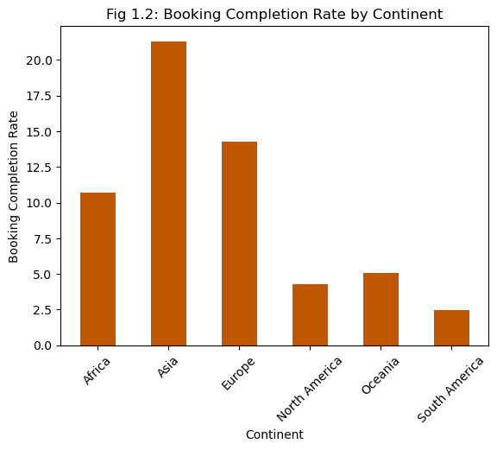
Data Exploration Insights - Continent
Most of the booking happens for travel from Asia followed by Oceania
Asia has highest booking completion rate followed by Europe and Africa respectively
Notes:
This may have been the most notable of all initial insights as the data had a vast majority of its observations coming from Asia and Oceania compared to other continents. We also observed a wide range of booking rates based on continent, but focusing primarily on Asia vs Oceania (since the other continents' samples were quite small), we see that Asia has nearly 5x the booking rate of Oceania

Slide 10
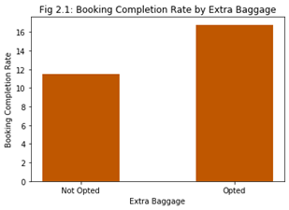
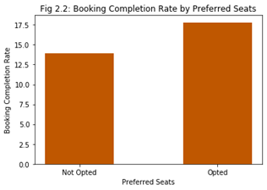
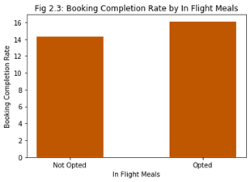
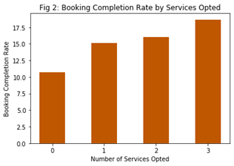
Data Exploration Insights - Optional Services
Customer who opted for any of the three services have a higher chance of booking completion
Notes:
Optional services was also notable since this is something that airlines have more control over (in terms of how these services are sold/marketed). We saw that for each individual service, booking rate was notably higher for those who had opted into the service vs those who had not. More so, we saw that as the number of services opted into incrased, the booking rate also continued to increase.

Slide 11
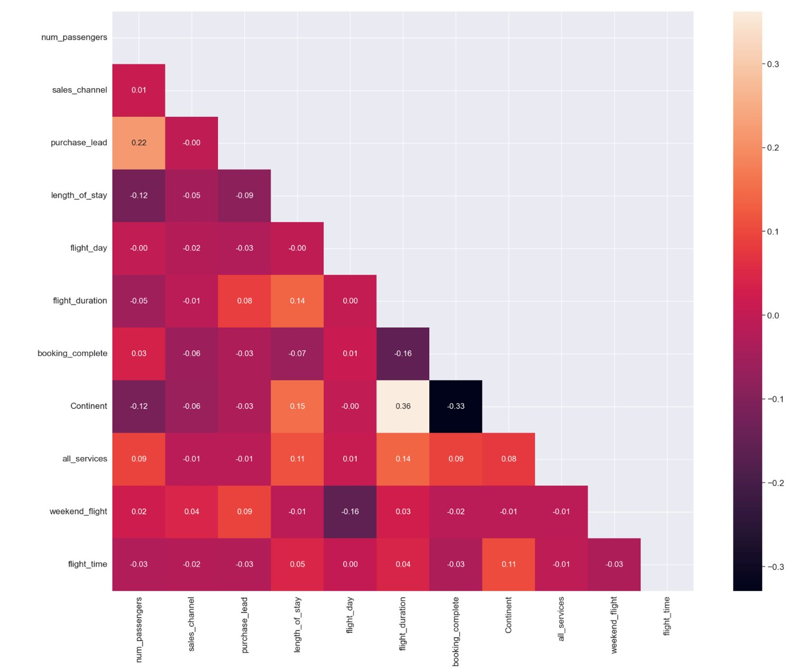
Correlation Matrix does not show any strong correlation between the variables
Notes:
Correlation matrix did not show any clearly strong relationships between variables. That said, out of all the variables/relationships, the highest correlation observed was –0.33 between continent and booking_complete (our response variable). This aligns with what we observed with clear differences in booking rate between continents on slide 9.

Slide 12
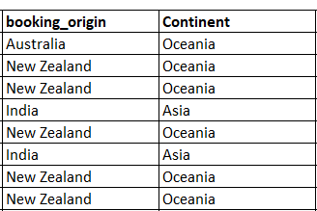
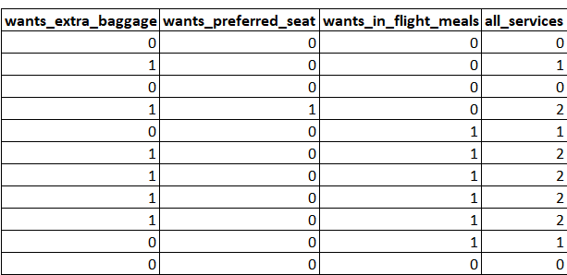
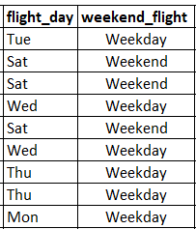



New variables are created, and some variables are dropped to extract relevant information from the dataset (1/2)
booking_origin have been grouped into continent for a less granular picture
A new variable indicating request of any additional services by the customer is created
flight_day are regrouped into weekday and weekend
Notes:
We added a new column called continent by converting the booking_origin feature, which is the origin country from where the booking was made, to display the continent instead of country, reducing the granularity.
Also, we added a new variable called all_services to display the total number of services opted for on a booking to understand the impact of services on the booking completion rate.
Flight day is another column that we tweaked and made into a binary column of Weekday or Weekend instead of showing the day of the week.

Slide 13
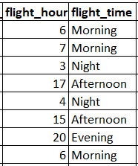
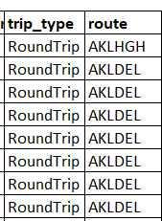



New variables are created, and some variables are dropped to extract relevant information from the dataset (2/2)
purchase_lead variable indicating days between the booking date and the date of travel has been grouped into 10 bins
flight_hour has been grouped into four groups i.e. Morning, Afternoon, Evening and Night
trip_type and route are dropped from the dataset as they are either skewed or do not provide meaningful insight
Notes:
The feature flight_hour explains the flight start hour, which we split into four buckets: Morning, Afternoon, Evening, and Night, making it easy to handle.
Additionally, we dropped trip_type and route columns from the dataset as we found them to have no significant impact on the booking completion rate.

Slide 14
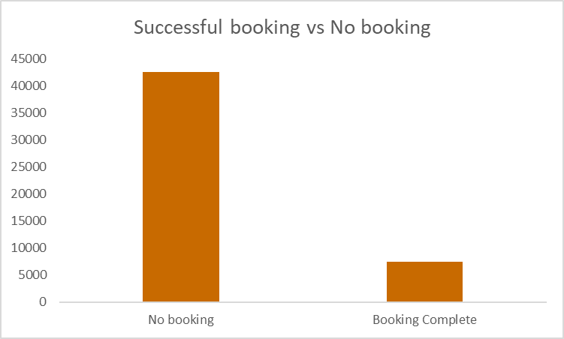
The input data is skewed with majority of itinerary opting out of booking
Note: To counter this inherent biasedness of data we will be selecting a random data sample with 50:50 split between booking and no booking for the modelling
Notes:
Since the original data was heavily skewed with many more incomplete bookings than complete bookings, we randomly selected out of the incomplete bookings to create a 50/50 split of completed and incomplete to base our models on. We also label encoded our categorical columns using a Label Encoder with the highest value in a particular column given to the category with the highest value count and rest of the column values following in a descending order. We then split our dataset into Training, Validation and Testing datasets with a approximately 55%, 25% and 20% split respectively.

Slide 15
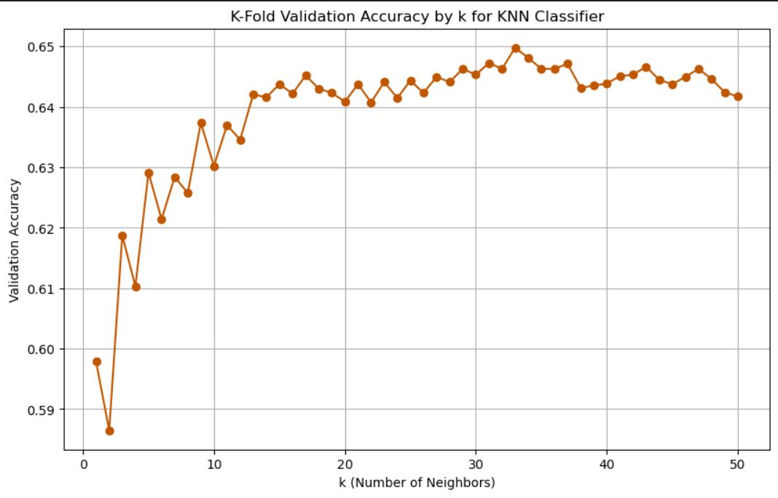
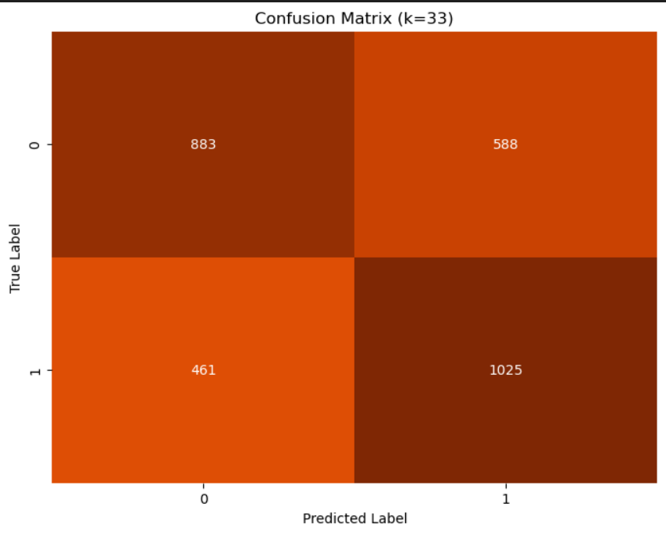
KNN Classifier
Test Data
Accuracy | Precision | Recall
64.5% | 63.5% | 68.9%
Notes:
We performed 5 fold cross validation and tested the model for a range of k starting from k = 1 to 50 and got best model accuracy for k = 33

Slide 16
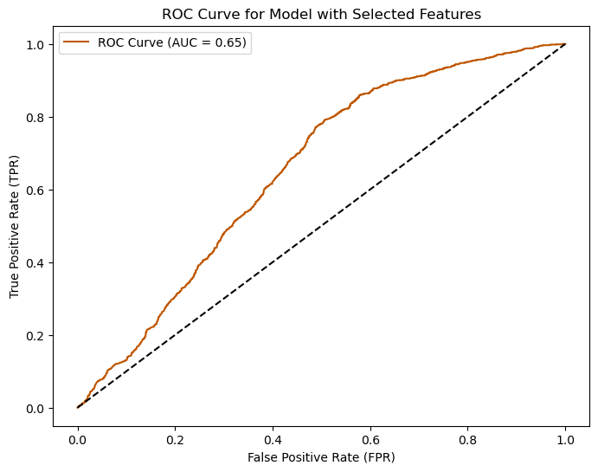
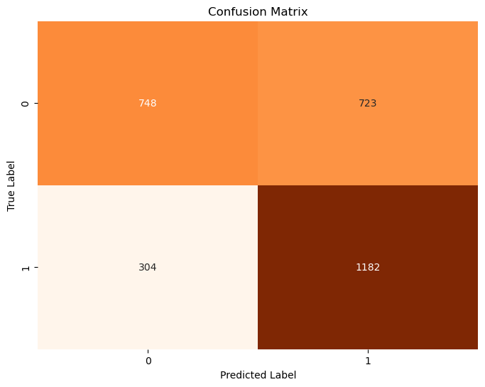
Logistic Regression
Test Data
Accuracy | Precision | Recall
65.2% | 62.0% | 79.5%
Notes:
Following on from the KNN model, we used a similar process flow to build and test our Logistic Regression Model. We trained an initial model with 5 fold cross-validation on all our features chosen after encoding. To try and improve the model performance, we used the p-values of our features to choose those which were significant to the model performance. We selected the features with p-values of less than 0.05. We trained a new model on the significant features and optimized the threshold by constructing an ROC Curve and maximizing the difference between the True Positive and False Positive Rate. The newer model had a higher recall but lower precision and the gap between the value of True Negatives and True Positives was significant compared to all models.

Slide 17
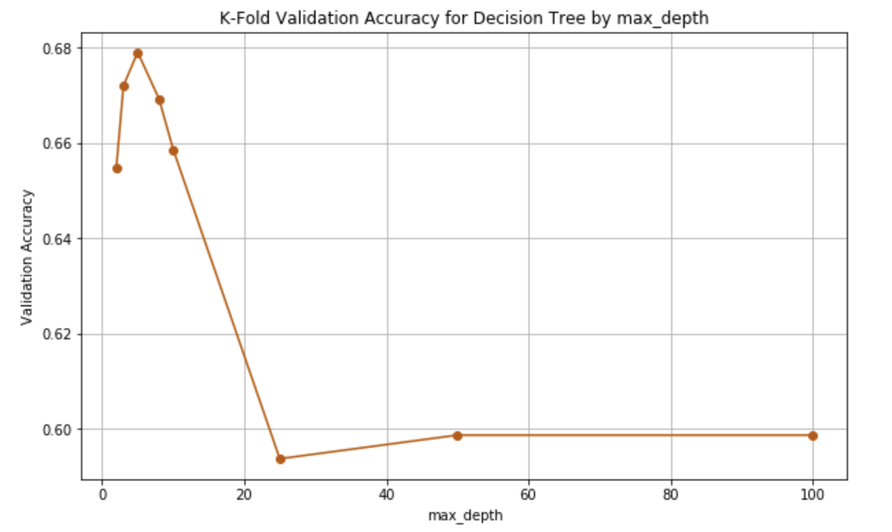
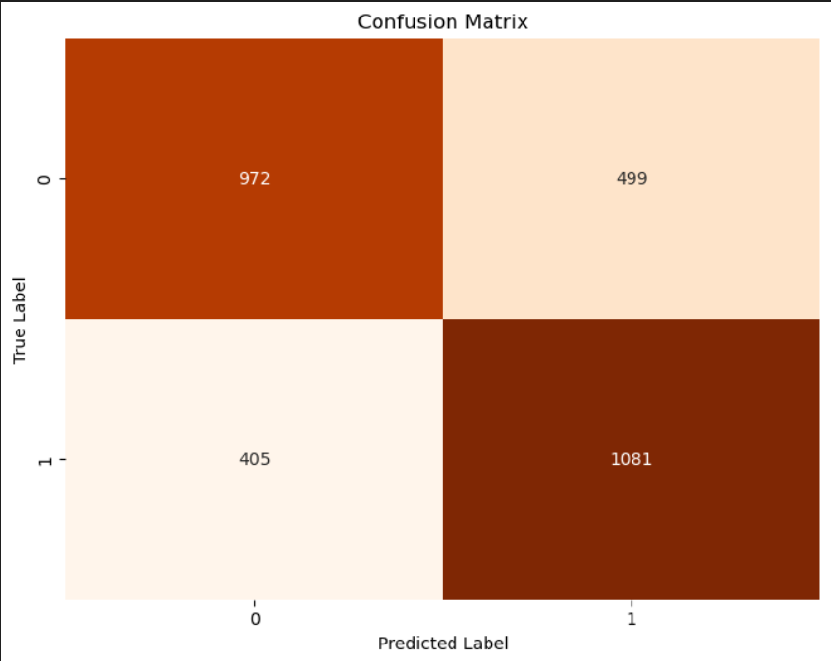
Decision Tree
Test Data
Accuracy | Precision | Recall
69.4% | 68.4% | 72.7%
Notes:
After working on parametric models, we turned our tables onto non-parametric models. Starting with Decision Tree.
Trained a decision tree classifier for various tree depths, with the minimum being 2, and the maximum being 100, and found a tree with depth = 5 to be the best tree with a validation accuracy of 67.8% which can be seen in the K-Fold Validation Accuracy Graph, and test accuracy of 69.4%, 68.4% as precision, and 72.7% recall.
Parameters for Best Model: Max Depth = 5 and Criterion = Gini
With a threshold of 0.55
There is a significant improvement in accuracy compared to the previous two models, KNN and Logistic Regression.

Slide 18
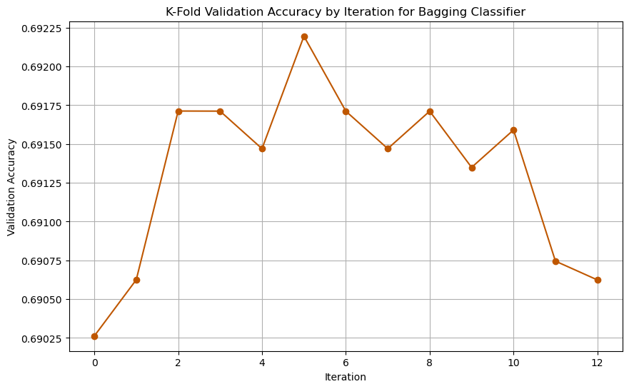
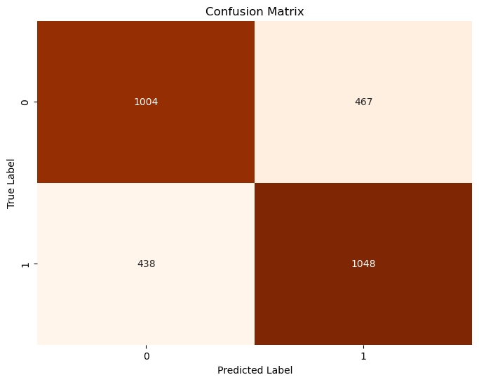
Bagging
Test Data
Accuracy | Precision | Recall
69.4% | 69.2% | 70.5%
Notes:
Tried range of n trees from 100 to 750 skipping by 50
Max tree depth of 5
Best n_estimators: 350 Validation Accuracy: 0.6877993801070724
Difference between test and validation accuracy is <1% (so no clear indication of over/under fit)
Was able to get precision and recall close together (and thus balance between TP/TN and FP/FN) by raising cutoff threshold from 0.5 to 0.55. Threshold at 0.5 resulted in higher recall but low precision with skew towards picking 1 (so more TP than TN, more FP than FN). So bumped up to 0.6 but saw skewing in other direction (picking 0 too often), and thus settled on 0.55. Throughout this adjustment process, accuracy varied slightly but was relatively stable.

Slide 19
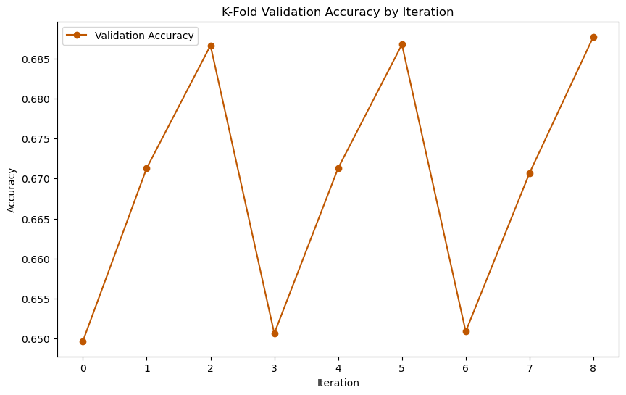
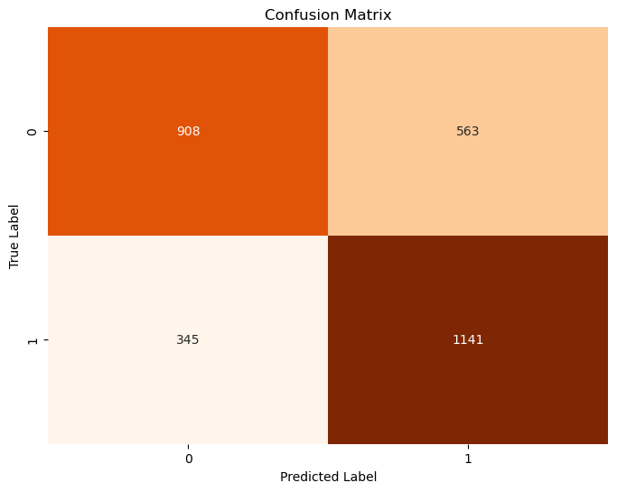
Random Forest
Test Data
Accuracy | Precision | Recall
69.29% | 66.9% | 76.7%
Notes:
List of n_estimators: [50,100,500]
List of max_depth: 2, 5, 10]
With hyperparameter tuning:
Max depth of 10
Best n_estimators: 500 Validation Accuracy: 0.6816004508312201
Threshold/cutoff value used:0.51

Slide 20
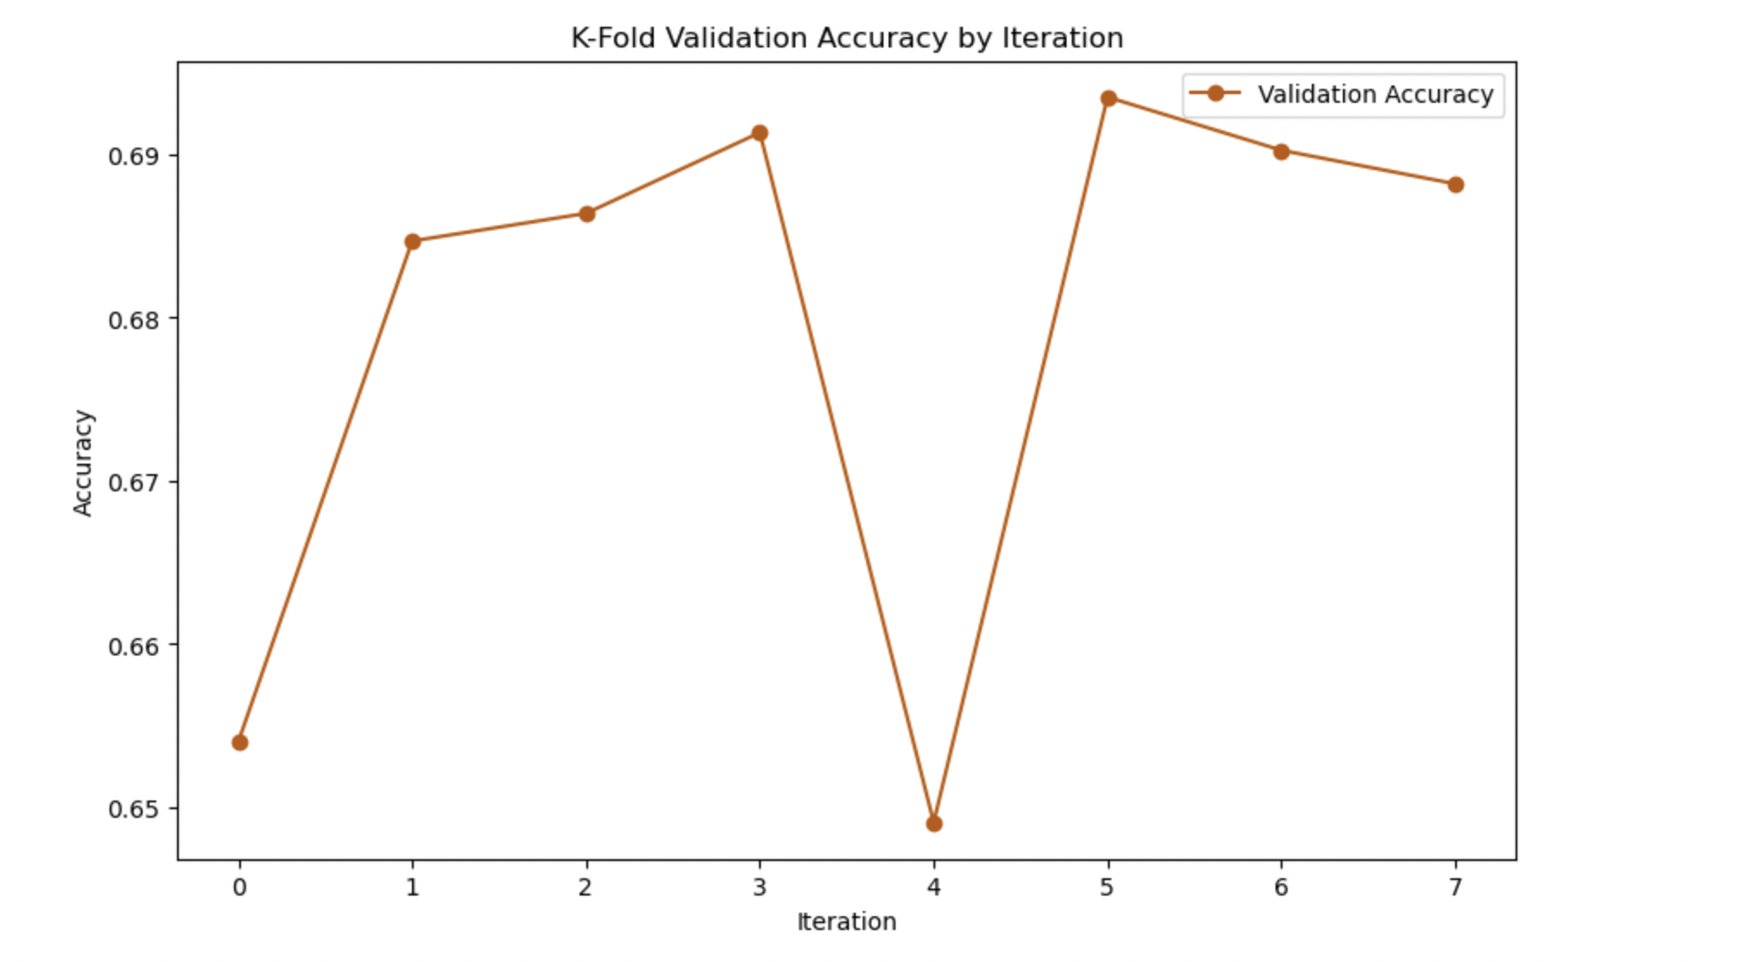
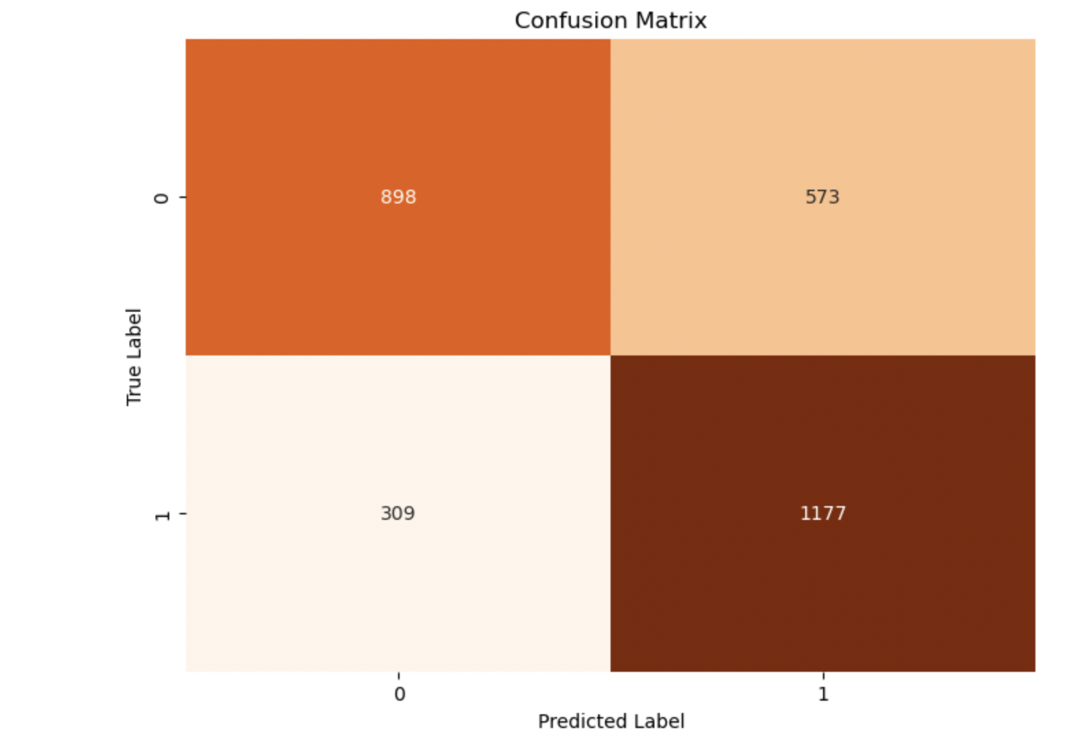
Boosting
Test Data
Accuracy | Precision | Recall
70.1% | 67.25% | 79.2%
Notes:
We ran different iterations by changing the hyper parameters of gradient boosting model - crushing factor ranging from (0.01,0.5), tree depth ranging from (2,10) and number of trees ranging from (50,1000). We got the best accuracy when we ran with the below hyperparameter settings
Number of trees = 100
crushing factor = 0.01
Tree depth= 5
Validation Accuracy: 0.7017247210010146
Threshold/cutoff value used: 0.51

Slide 21
Model Comparison
 | KNN | Logistic | Tree | Bagging | Random Forest | Boosting
Accuracy | 64.5 | 65.2 | 69.4 | 69.4 | 69.29 | 70.1
Precision | 63.5 | 62.0 | 68.4 | 69.2 | 66.9 | 67.25
Recall | 68.9 | 79.5 | 72.7 | 70.5 | 76.7 | 79.2
Model accuracy after boosting with random search has an accuracy of 70.3
Notes:
Boosting yielded the highest accuracy out of all the models tried.
This accuracy was further increased (from 70.1 to 70.3) when boosting with random search.

Slide 22
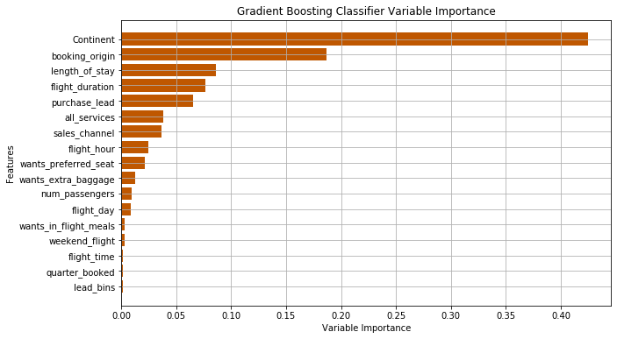
Variable Importance
Notes:
Continent/booking_origin (Continent being our binned version of booking_origin which was country-specific) were clearly the most significant variable, which aligned with our initial analysis where we saw Asia had nearly 5x the booking rate of Oceania. This could be an area worth exploring further (with more country/continet-specific data) as to why this large difference/significance exists.

Slide 23
Findings and Conclusion
Process
Boosting yielded highest accuracy in the Test Dataset.
Logistic Model, Decision Tree Models are Underfitting as the Test Accuracies are higher than the Validation Accuracies.
Problem
Further exploring differences in continent/booking origin (i.e. other factors specific to Asia vs. Oceania) may be key in understanding booking rates.
Getting more customers to opt into more services may increase booking rates.
Notes:
Used a threshold of 2% difference between test and validation accuracies to consider a model as possible under/over fitting.
As mentioned in previous slide, if we wanted to gain deeper understanding and seek more data to explore customer booking behavior, data regarding country/continent-specific differences may be worth investigating.
If we were to recommend immediate action for the airline to take to increase booking rates, incentivizing their optional services may be the best course of action. This is based on it being a relatively significant variable in predicting booking rate, but the only one which the airline has direct input into (vs. something like length_of_stay which is more significant, but not something the airline can easily use to its advantage)

Slide 24
Thank You !!

Slide 25
Questions?

